Slide 1

Sports Betting with Data Science
By Justin Tunley

Slide 2
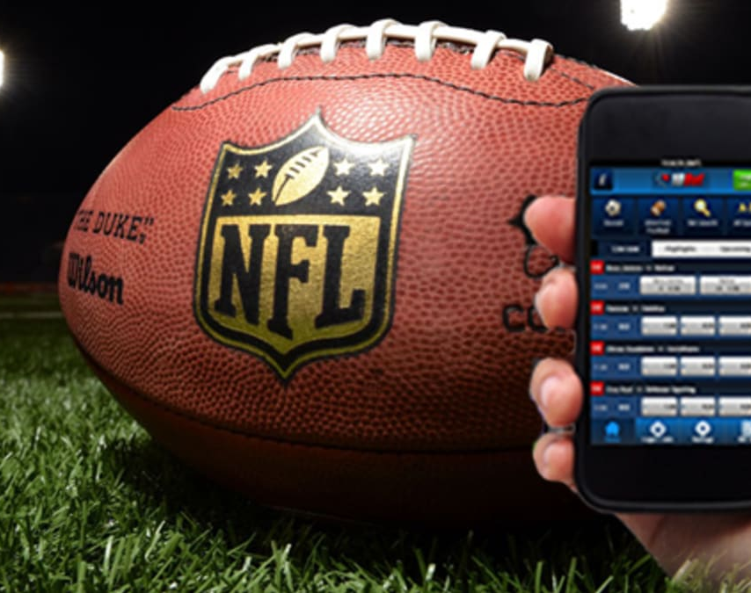
Problem Statement and Opportunity
Mobile sports betting generated $165.6m in New York in September 2023 (iGB)
73.5 million American adults have bet on NFL football this season (AGA)
How to we predict the outcome of NFL games?
1. Primary audience: Online Sportsbooks (FanDuel, Caesars, DraftKings, BetMGM)
2. Secondary audience: at-home betters searching for advantageous odds
Notes:
iGB = iGaming Business
AGA = American Gaming Association

Slide 3
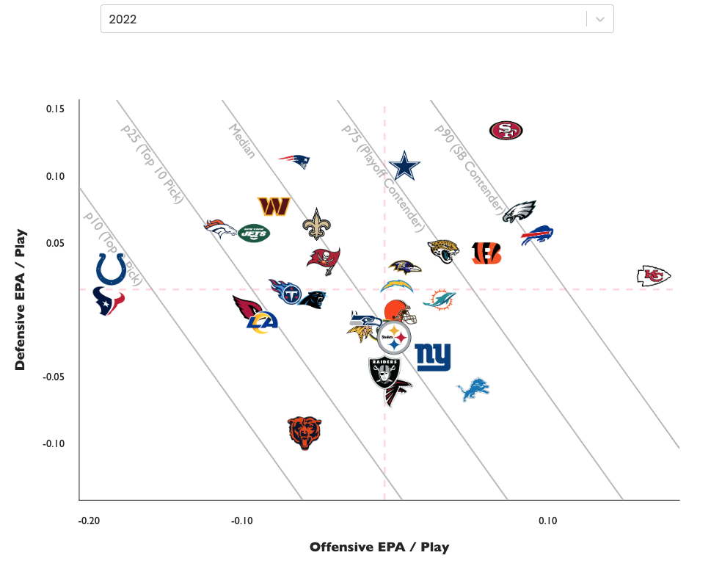
Methodology
2 Regression Models:
- Home Offense vs Away Defense
- Away Offense vs Home Defense
Target variable: Expected Points
Scaling Data Sets
- In-season data: Bye Weeks
- Historical data: Games

Slide 4
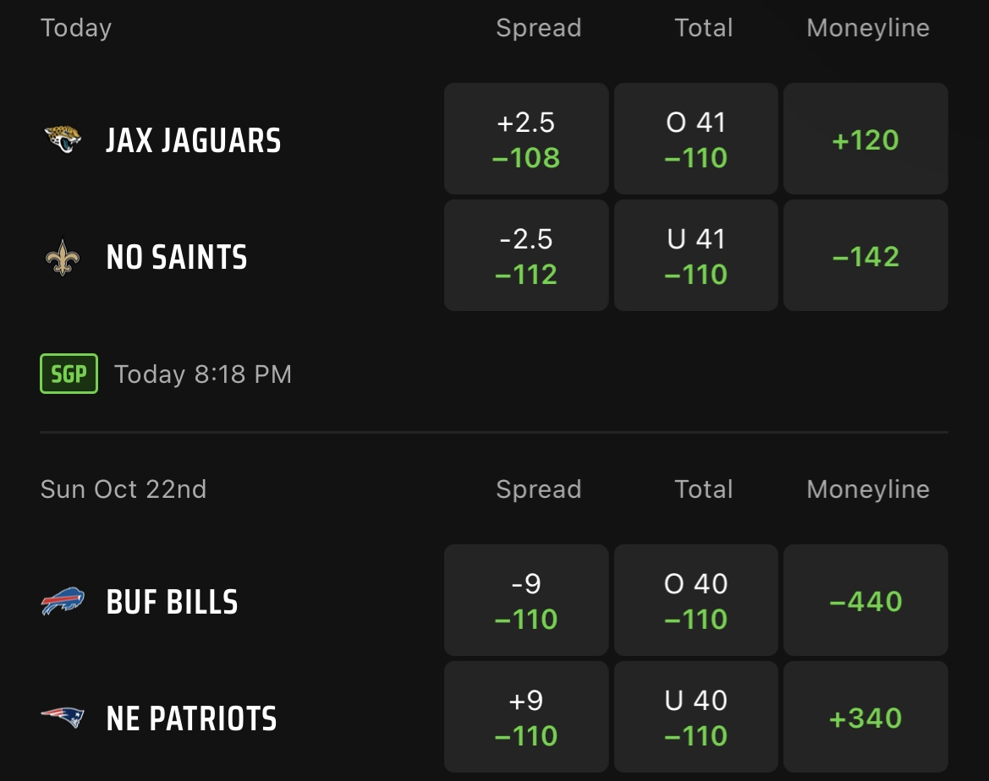
Impact
Help people make informed decisions on 3 key outputs:
Moneyline
Who is going to win?
Spread
How much will the better team win by?
Point Total
How many points will the teams score combined?
Sports Books set the line as close to even as possible to ensure profits.
Betters can compare their lines with those from the books to find profitable bets.

Slide 5
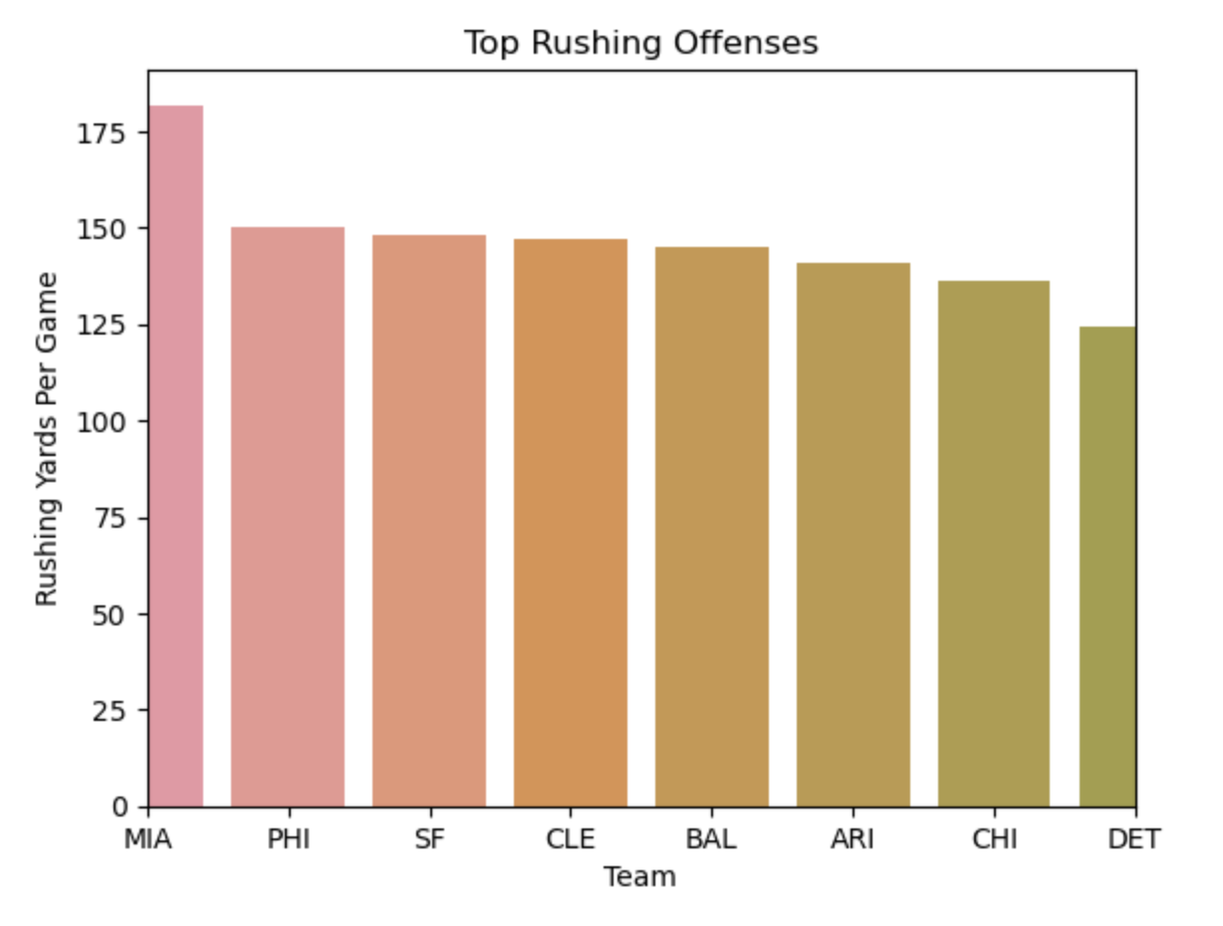
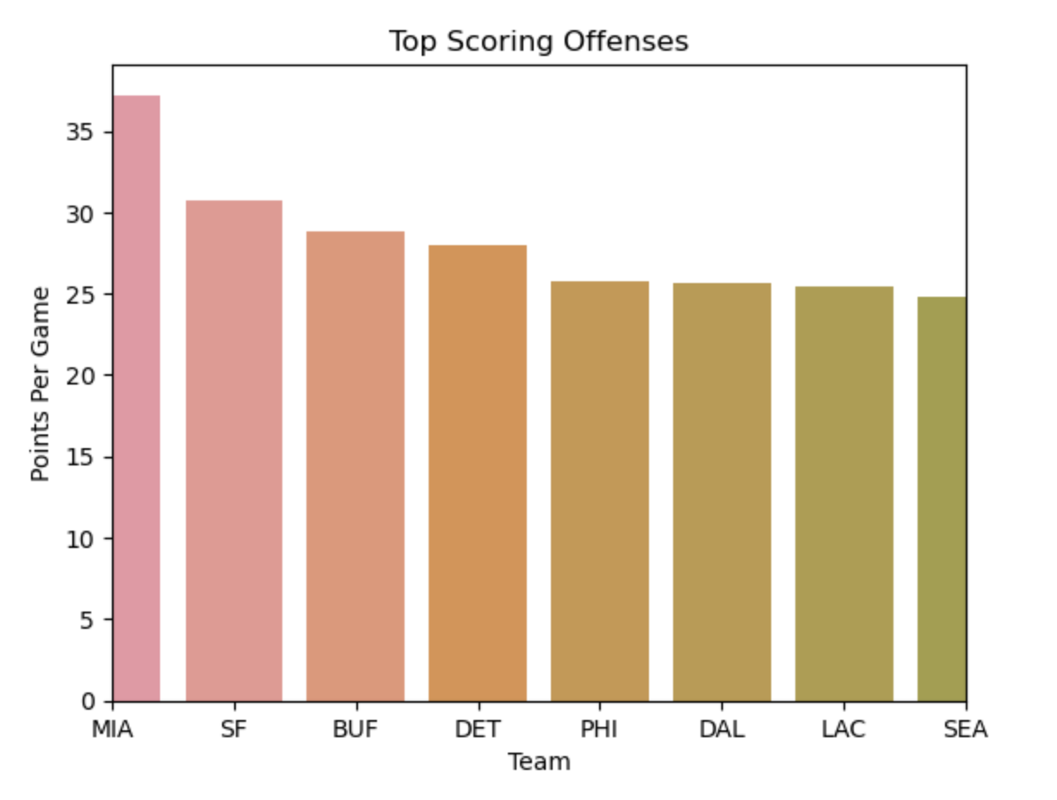
Introducing the Data Sets
Offensive Metrics:
Points per game, rushing yards per game, passing yards per game.
Formations and tendencies
How many wide receivers are on the field? Do they use more than one TE?
Play call breakdown:
How many pass plays vs run plays?
Penalties per game and penalty yards per game
Depth-of-target
Are they taking risks throwing down-field or

Slide 6
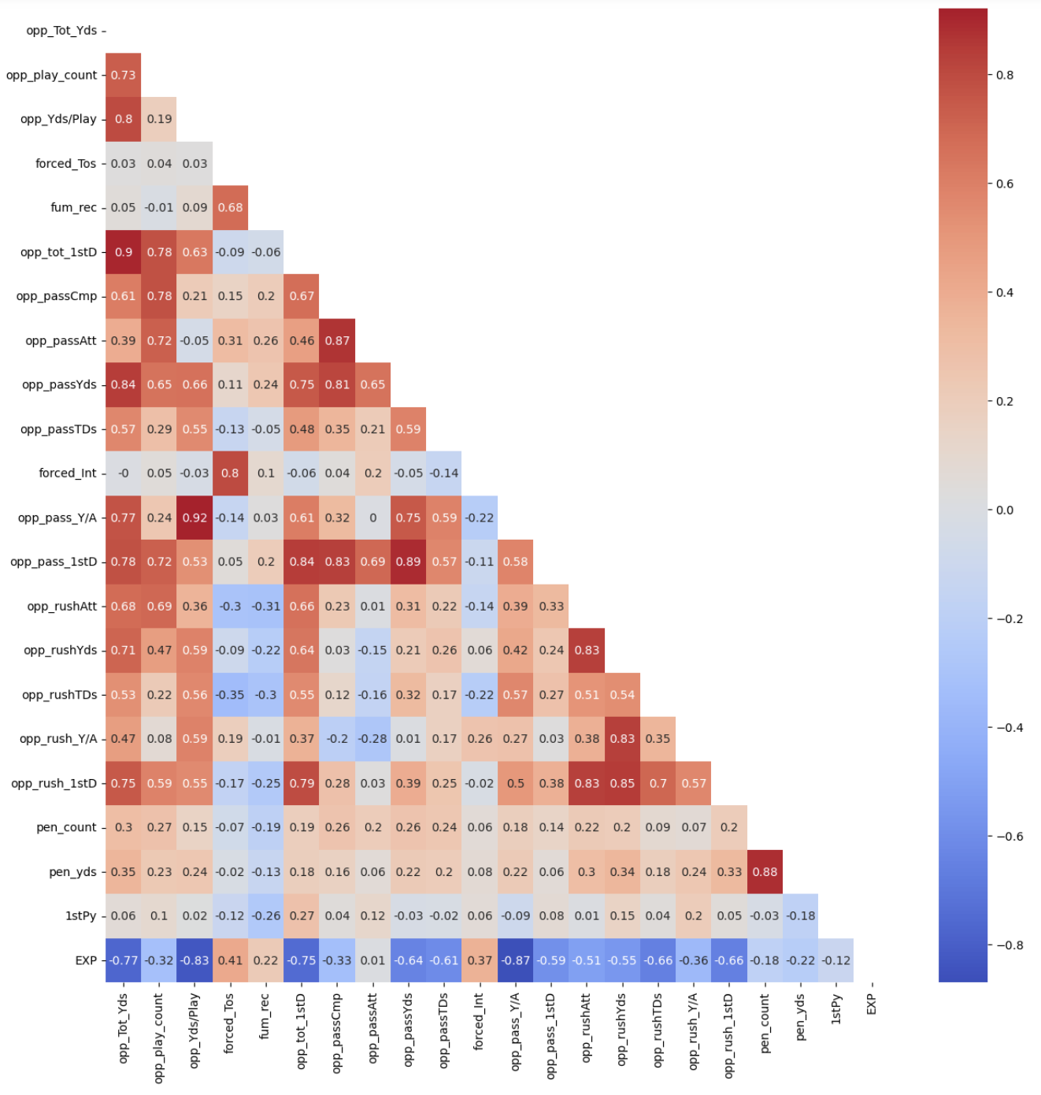
Introducing the Data Sets
Defensive Metrics:
Tracking how teams playing against them perform in the same metrics
Defensive tendencies and formations
Do they prefer a 4-3, 3-4, dime or nickel formations?
Do they run a zone or man defense?
How quickly do they pressure the opposing QB?

Slide 7
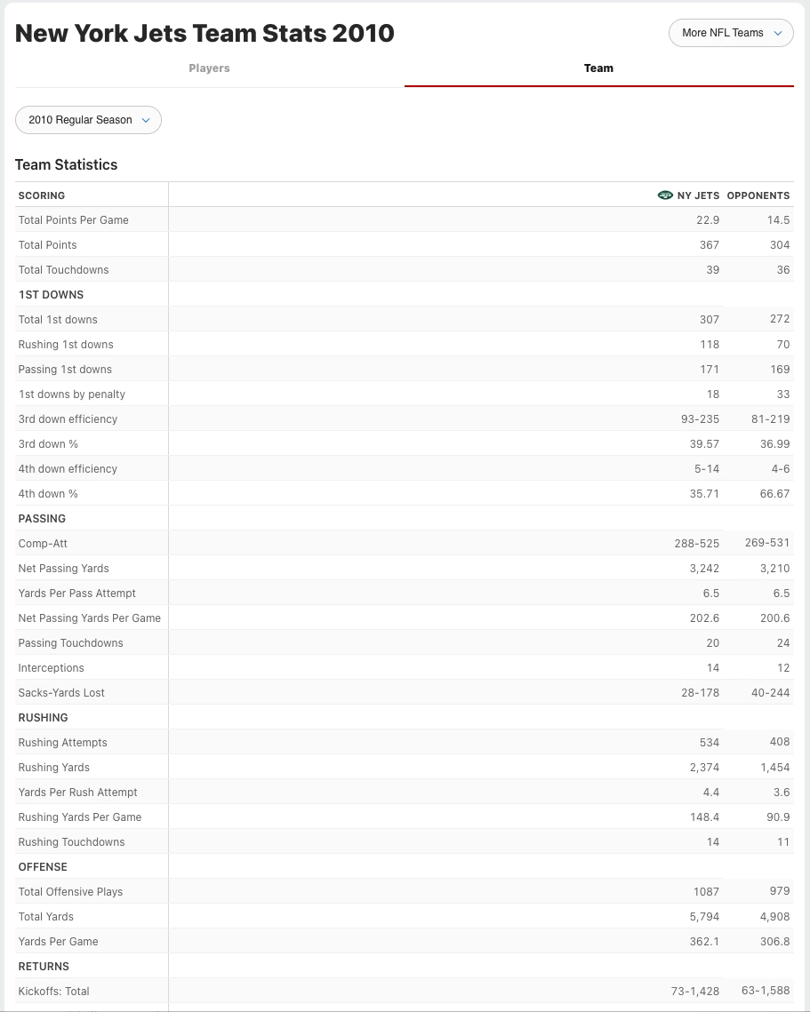
Next steps
Keeping up-to-date data sets
Option 1: Scraping from ESPN
Option 2: Sportsbetting api
Adding features to team offense
Redzone conversion rate
Turnovers
Player bonuses:
The Tom Brady Effect
Combining team offense and team defense in a single regression.
Special Teams (kick / punt returns) metrics
In 2007, Devin Hester broke the record for kick returns in a season with 6. That’s 36 points not currently being counted for the Bears in 2007

